Slide 1
Difference between AlexNet, VGGNet, ResNet, and Inception

Slide 2
Convolution Parameters
In convolution layer, it accepts a volume of size W x H x D and requires four hyper parameters as follows:
Number of filters → K
Spatial Extent → Fw, Fh (Filter width, Filter height)
Stride → Sw, Sh (Stride width, Stride height)
Padding → P

Slide 3
AlexNet
Why? AlexNet was born out of the need to improve the results of the ImageNet challenge. This was one of the first Deep convolutional networks to achieve considerable accuracy on the 2012 ImageNet LSVRC-2012 challenge with an accuracy of 84.7% as compared to the second-best with an accuracy of 73.8%. The idea of spatial correlation in an image frame was explored using convolutional layers and receptive fields.

Slide 4
AlexNet
What? The network consists of 5 Convolutional (CONV) layers and 3 Fully Connected (FC) layers. The activation used is the Rectified Linear Unit (ReLU). The structural details of each layer in the network can be found in the table below.

Slide 5
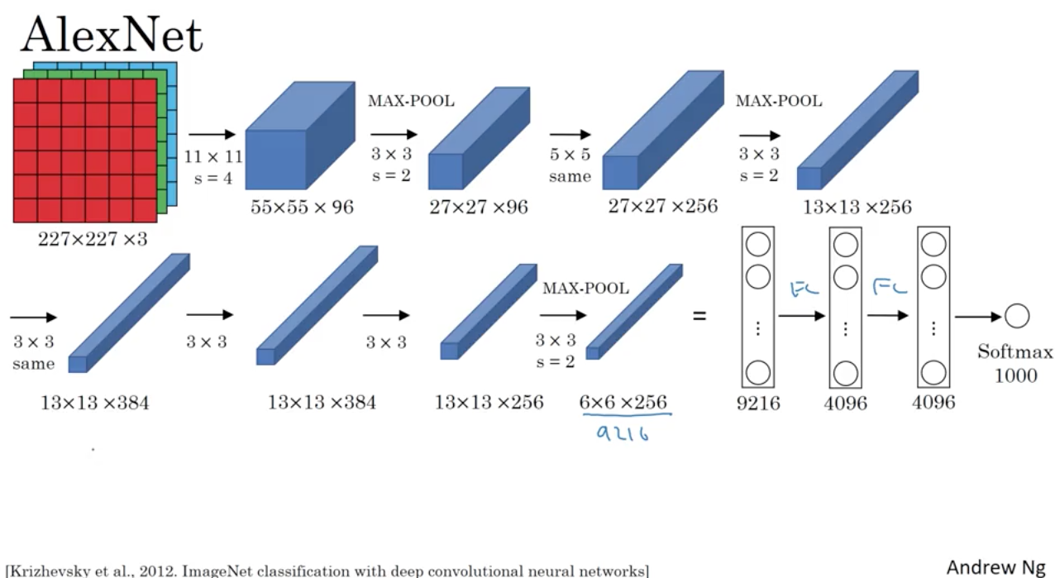

Slide 6
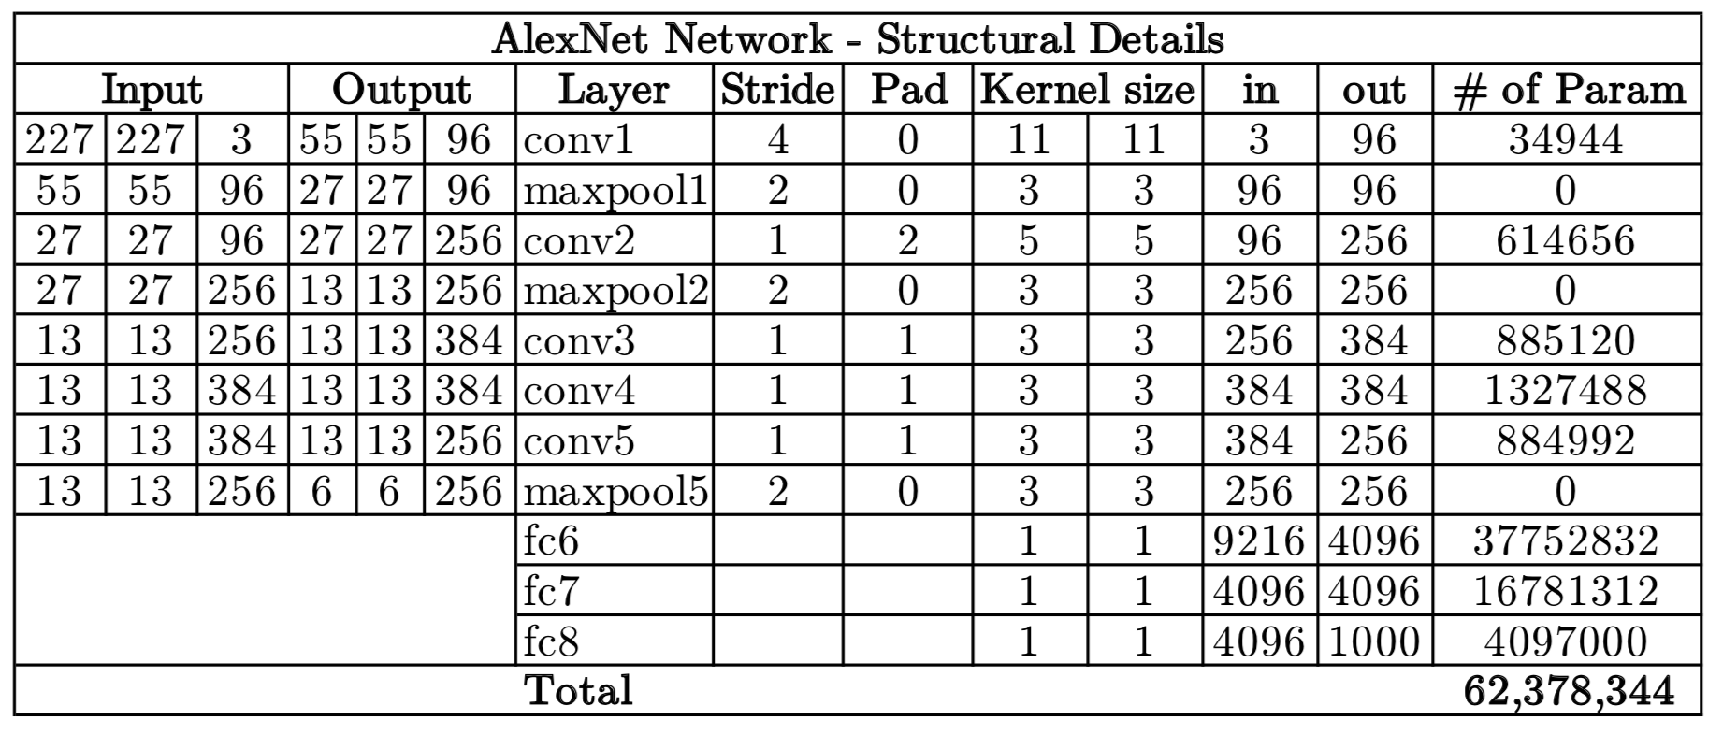

Slide 7
The network has a total of 62 million trainable variables

Slide 8
VGGNet

Slide 9
VGGNet
Why? VGGNet was born out of the need to reduce the # of parameters in the CONV layers and improve on training time.

Slide 10
What? There are multiple variants of VGGNet (VGG16, VGG19, etc.) which differ only in the total number of layers in the network. The structural details of a VGG16 network have been shown below.

Slide 11
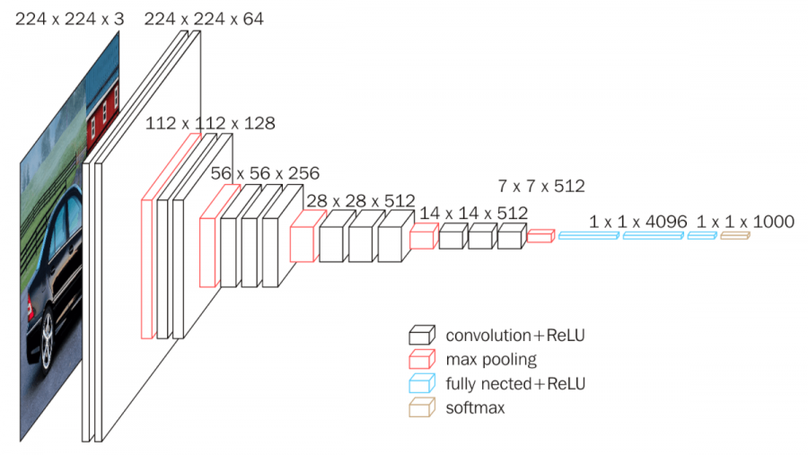
VGGNET-16

Slide 12
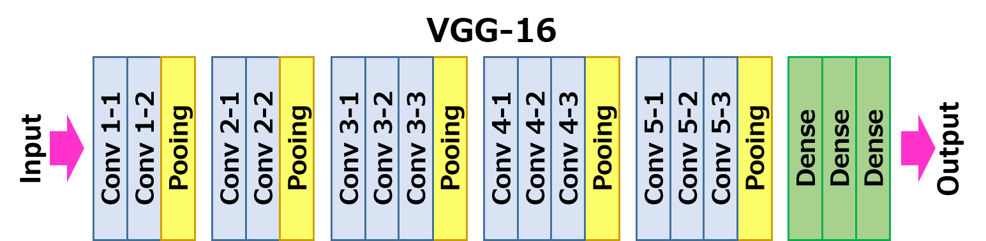

Slide 13
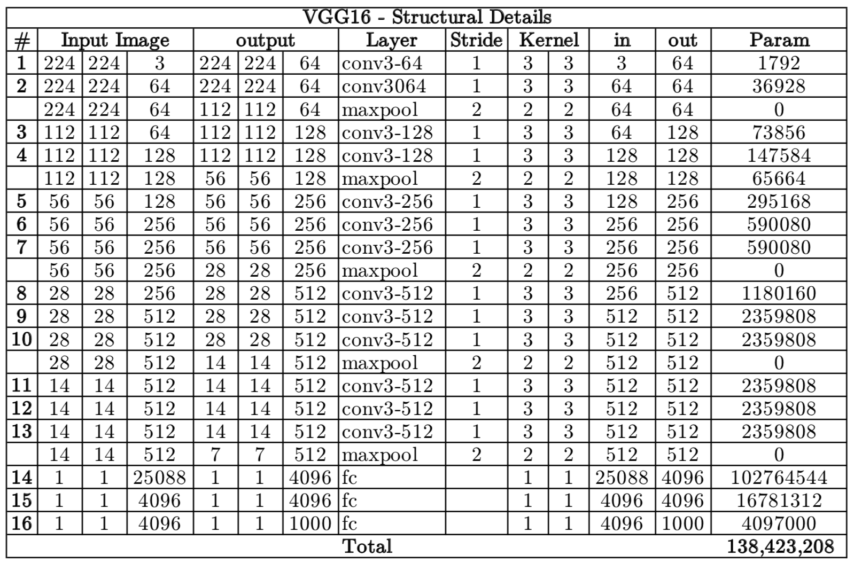

Slide 14
VGG16 has a total of 138 million parameters. The important point to note here is that all the conv kernels are of size 3x3 and maxpool kernels are of size 2x2 with a stride of two.

Slide 15
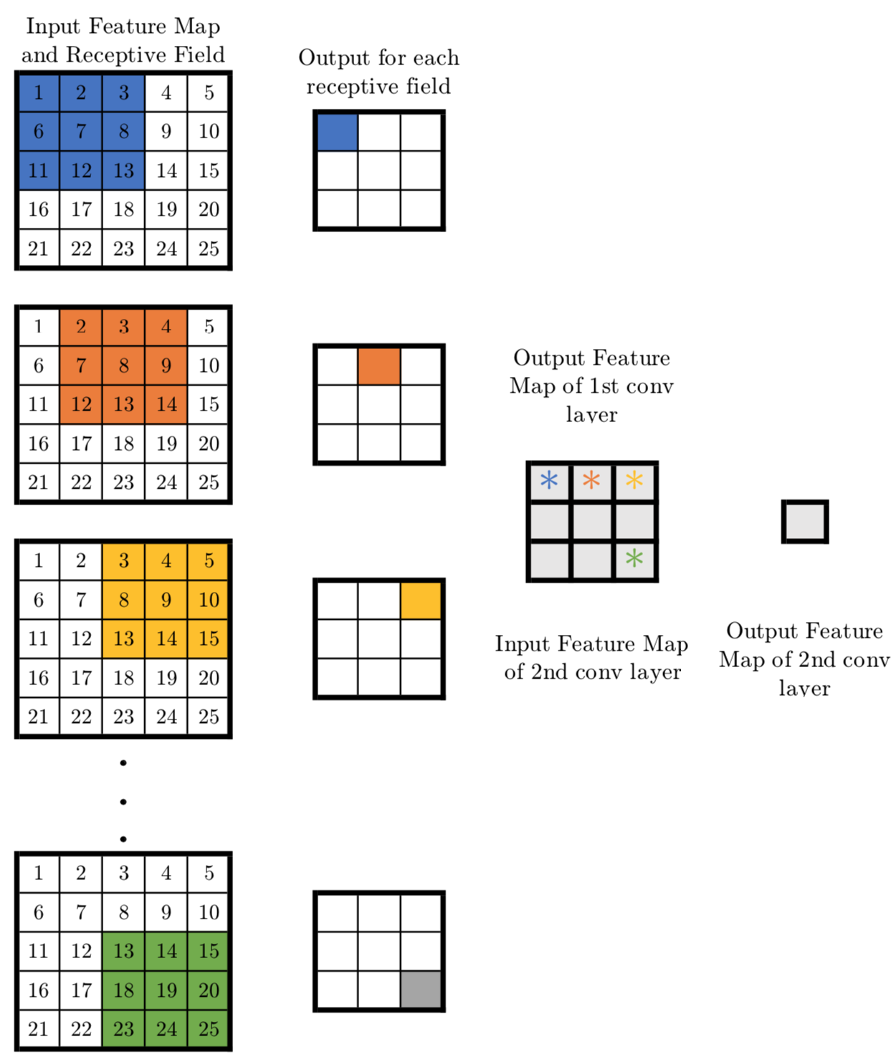

Slide 16
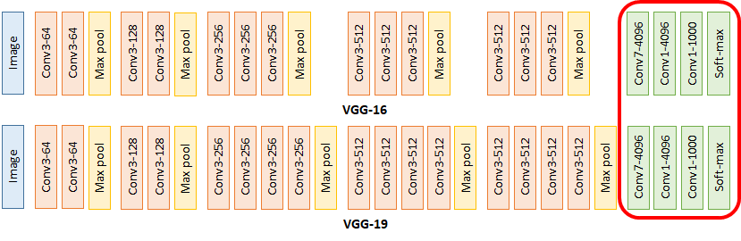
VGGNET-16 Vs 19

Slide 17
GoogLeNet
Large-Scale Visual Recognition Challenge 2014 (ILSVRC14).
One particular incarnation used in our submission for ILSVRC14 is called GoogLeNet, a 22 layers deep network, the quality of which is assessed in the context of classification and detection.
Inception V1 (It achieved a top-5 error rate of 6.67%)
This was very close to human level performance which the organisers of the challenge were now forced to evaluate

Slide 18
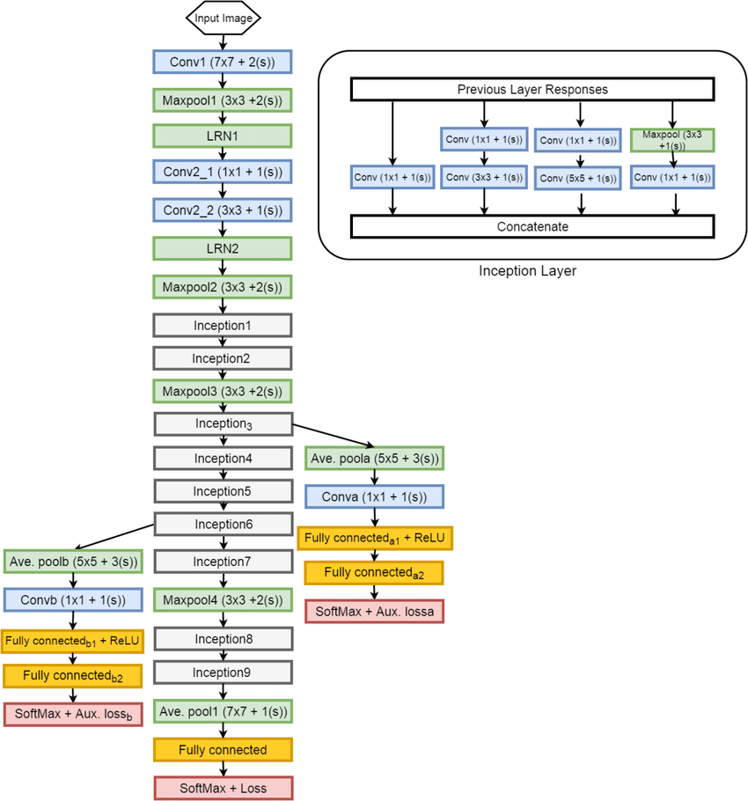

Slide 19
Their architecture consisted of a 22 layer deep CNN but reduced the number of parameters from 60 million (AlexNet) to 4 million.
GoogLeNet/Inception(2014)

Slide 20
ResNet(2015)
At last, at the ILSVRC 2015, the so-called Residual Neural Network (ResNet) by Kaiming He et al introduced anovel architecture with “skip connections” and features heavy batch normalization.
Such skip connections are also known as gated units or gated recurrent units and have a strong similarity to recent successful elements applied in RNNs.

Slide 21
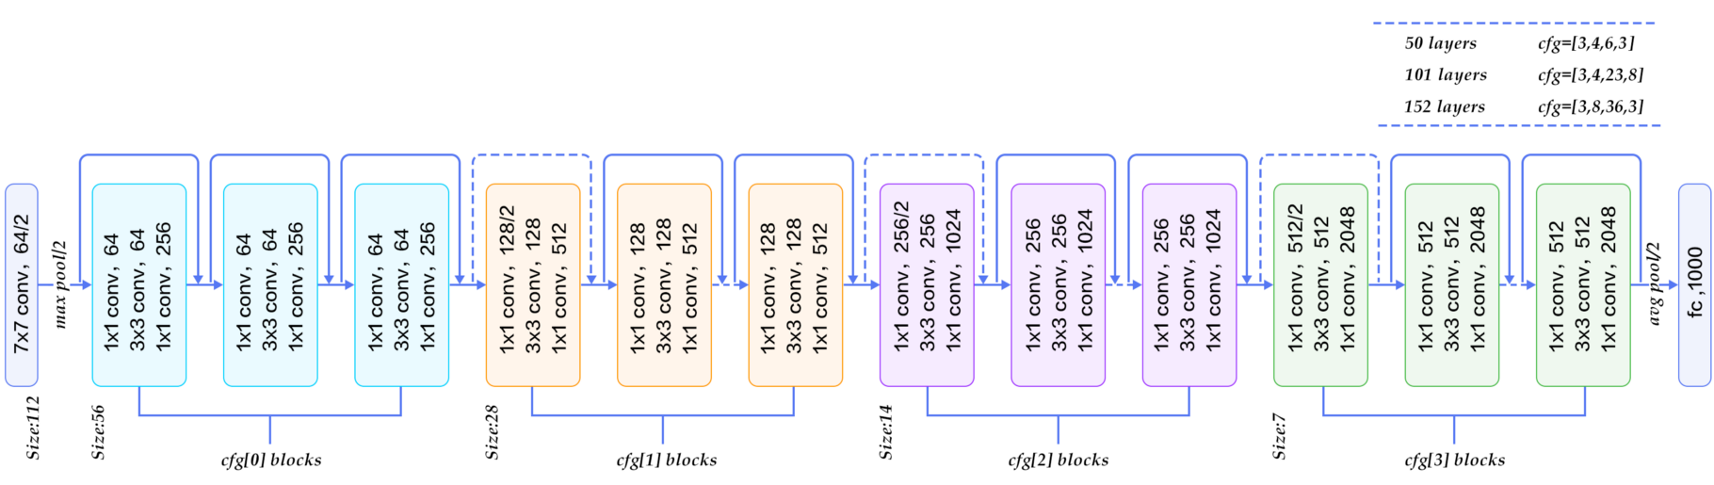

Slide 22
Thanks to this technique they were able to train a NN with 152 layers while still having lower complexity than VGGNet. It achieves a top-5 error rate of 3.57% which beats human-level performance on this dataset.

Slide 23
